Slide 1










Interim Presentation
Carla
Carmen
Eliott
Jan
Julia
by

Slide 2



– Team 2
Problem Statement
“What is the city but the people?”
– William Shakespeare (Coriolanus, Act 3, Scene 1)
People have a high barrier when it comes to participation in urban planning, for this reason, only a small population group takes advantage of participation opportunities.
At the same time, comprehensive citizen participation offers numerous advantages.
“While planners bring technical skills and knowledge, citizens provide community history, local knowledge, and an understanding of cultural values.”
– Healey 1992; Innes 1996, 1998; Talen 1999

Slide 3


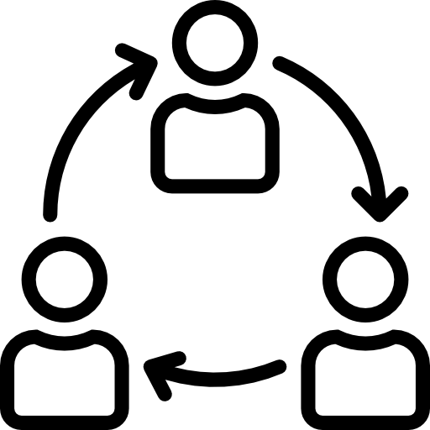







– Team 2
State of the Art
Existing methods of citizen participation fail to involve a diverse group of people. This is due to:
High time investment
Project complexity
One-way flow of information
Participation only possible in late project stages
Unawareness of possibilities
Inhibitions to speak out in public
Modern technologies in an intelligent city can solve some of these problems if they are used properly.

Slide 4







– Team 2
Project Management
SCOPE
TIME
PEOPLE
COMM​NICATION
RISK

Slide 5


– Team 2
SWOT Analysis
S
W
O
T
STRENGTHS
WEAKNESSES
OPPORTUNITIES
THREATS
Low barrier to participate for citizens
Visual experience
Background information of a project is not required
Easy access
User experience
Active interaction
One participant at one time with the active part
Limited budget
No attraction to see our screen/people’s attention
Private voting
No competitors on the market
Reaching a new target group
People get bored by this device
Competitors that failed
Government is making empty promises
Government is not interested in this device

Slide 6
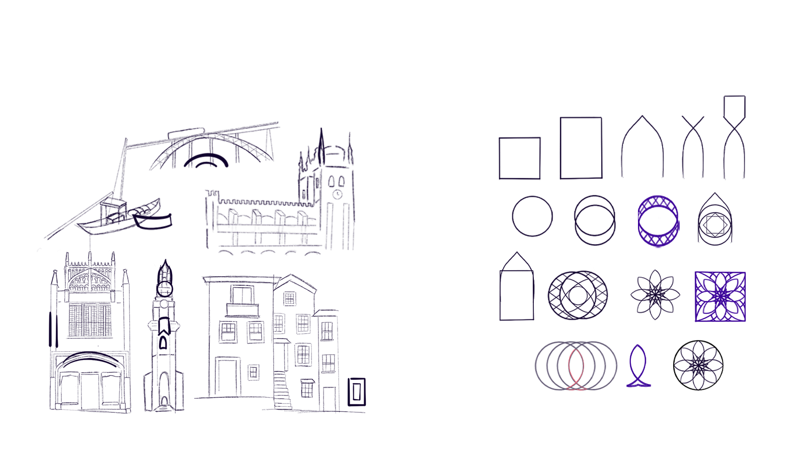
– Team 2
Logo Design

Slide 7

– Team 2
Logo Design and Color Palette
#5028EF
#F40076
#4E6E58
#E6E6E7
#000000

Slide 8
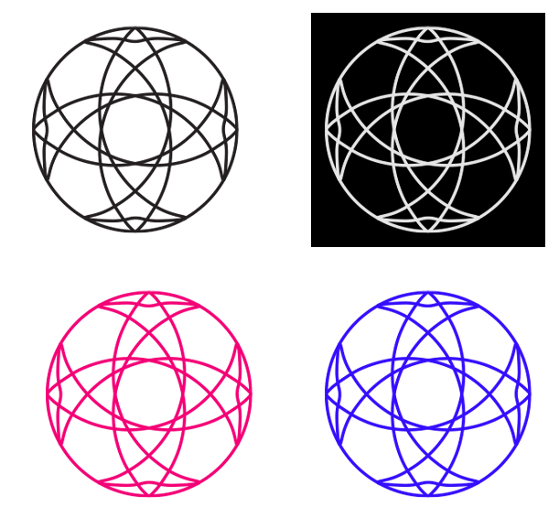

– Team 2
Logo Variants
Horizontal
Vertical
Monogram

Slide 9
– Team 2
USER
Sustainability
Blackbox
Energy
ELECTRICITY GRID
Screen
Website frontend
Network
ELECTRICITY GRID
Web-server
(+API)
ENERGY SOURCE
Computer
&
Browser app
Sensors
(light, motion)
Database
SOLAR PANNELS
+ BATTERY
System

Slide 10
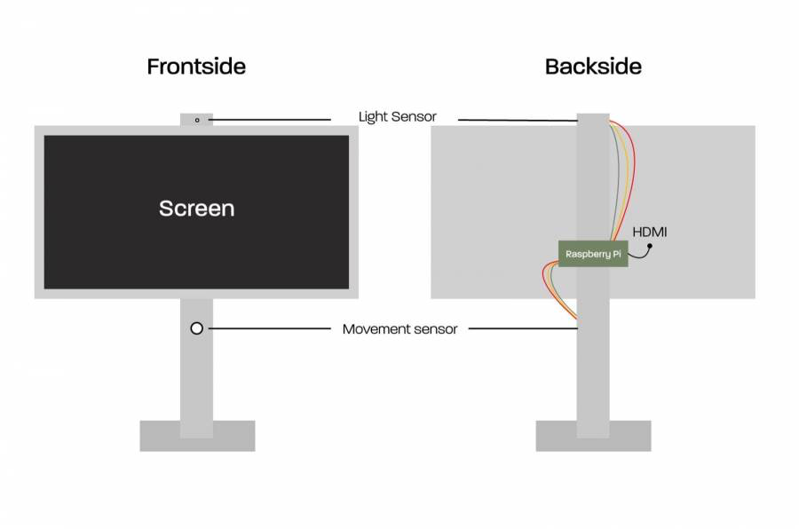
– Team 2
Sustainability
Materials
Structure design
Energy
Replaceable components
Recycled materials
Single material parts
Less amount of material used
Low impact manufacturing
Structural draft

Slide 11

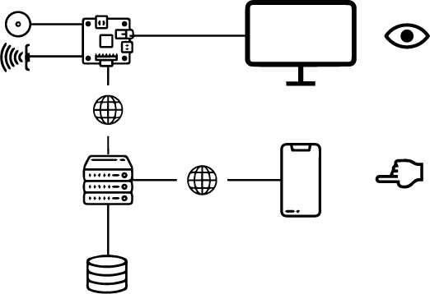




– Team 2
Software: System Components & Technologies

Slide 12
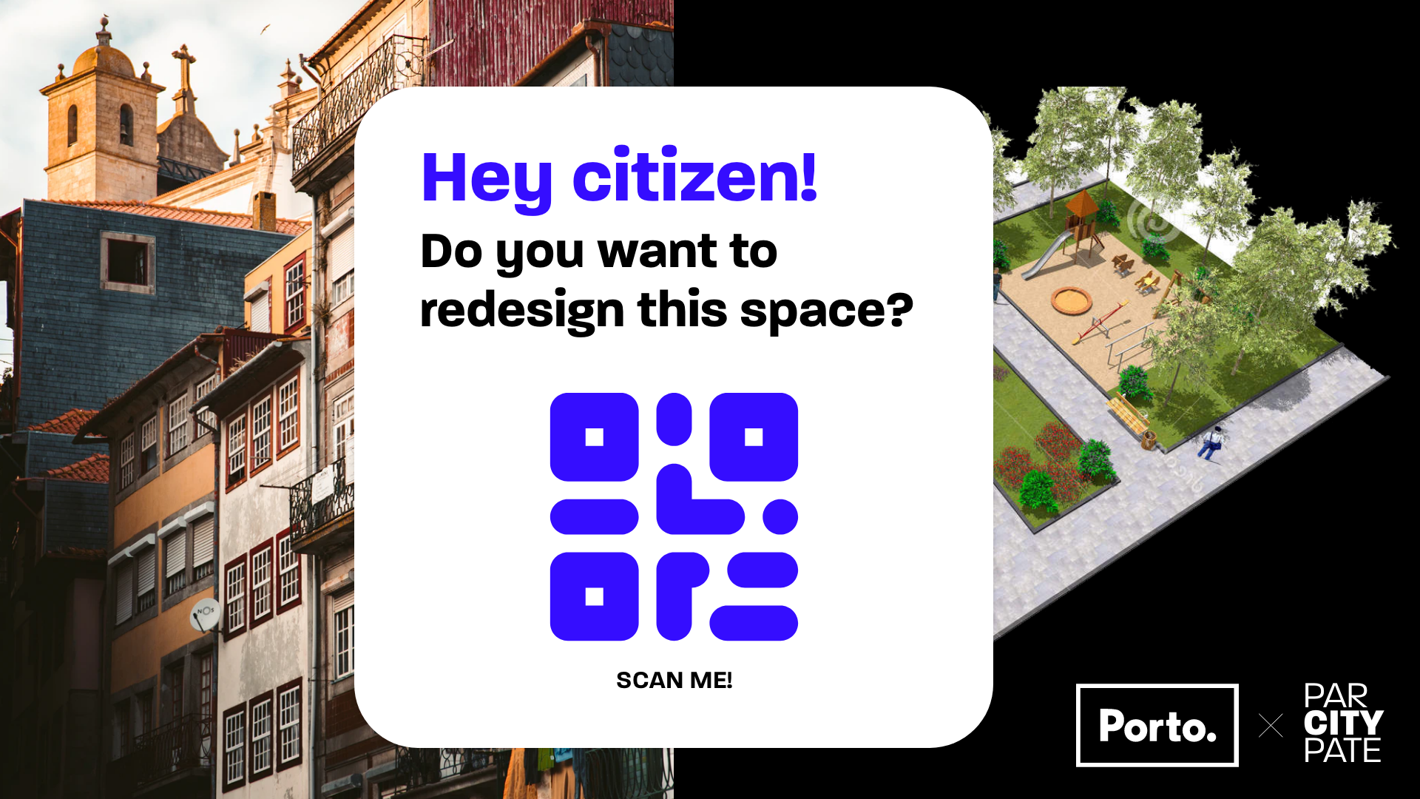
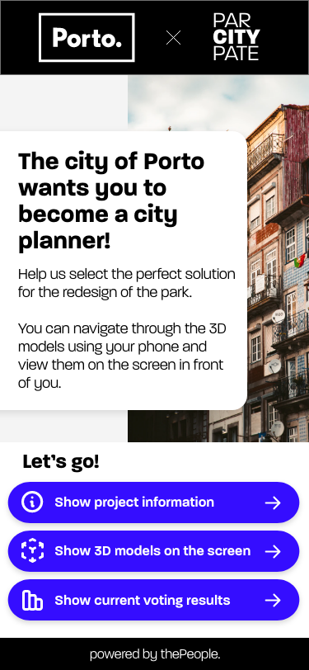
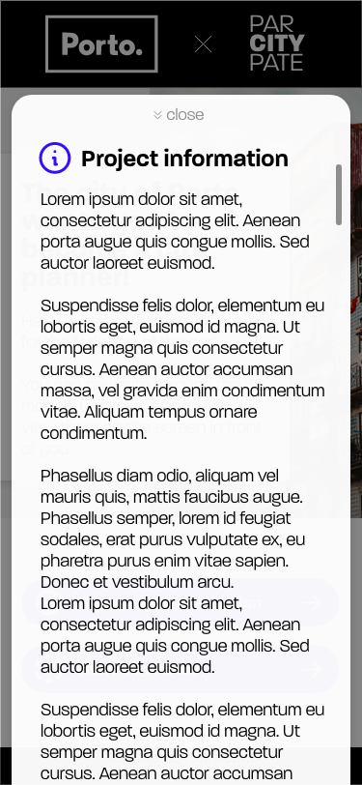
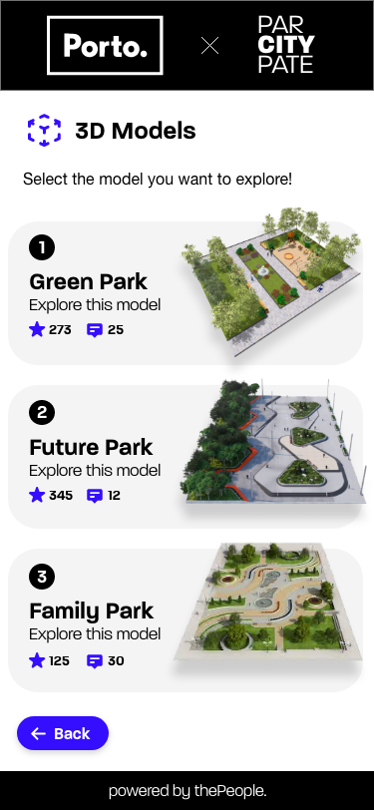
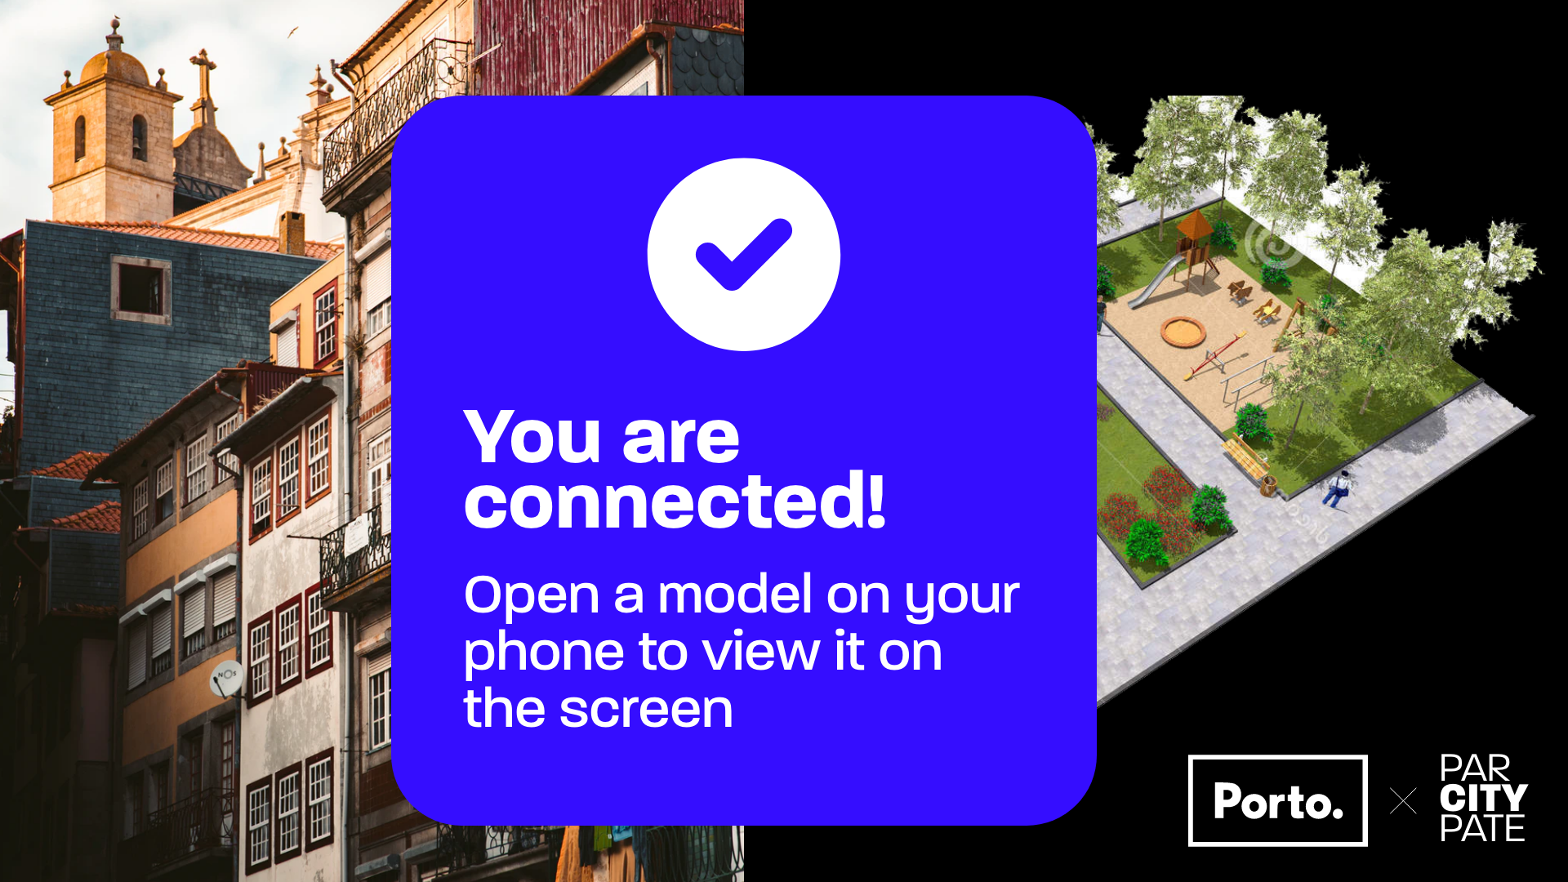
– Team 2
Mockups: Start connection & information

Slide 13
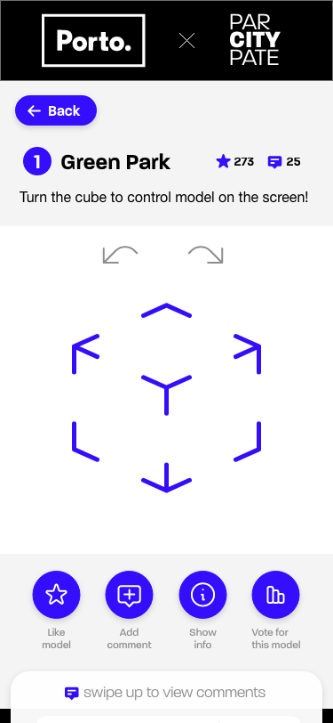
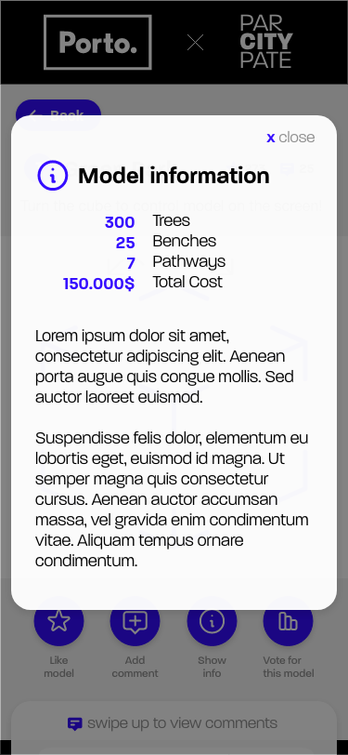
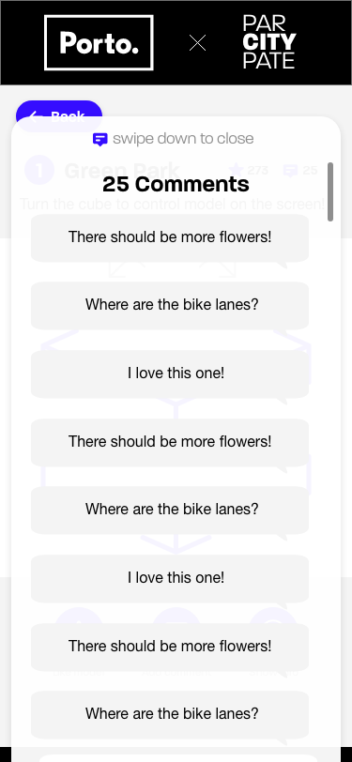
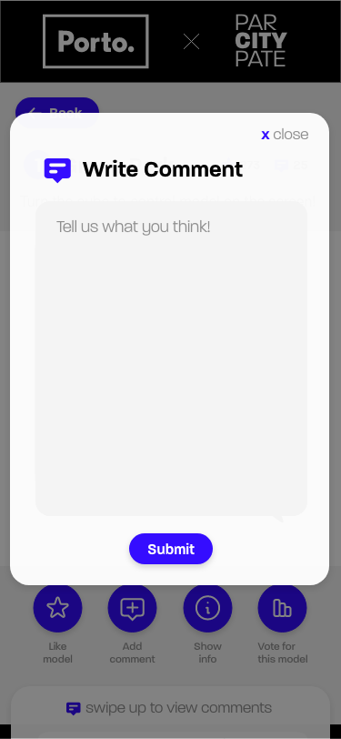
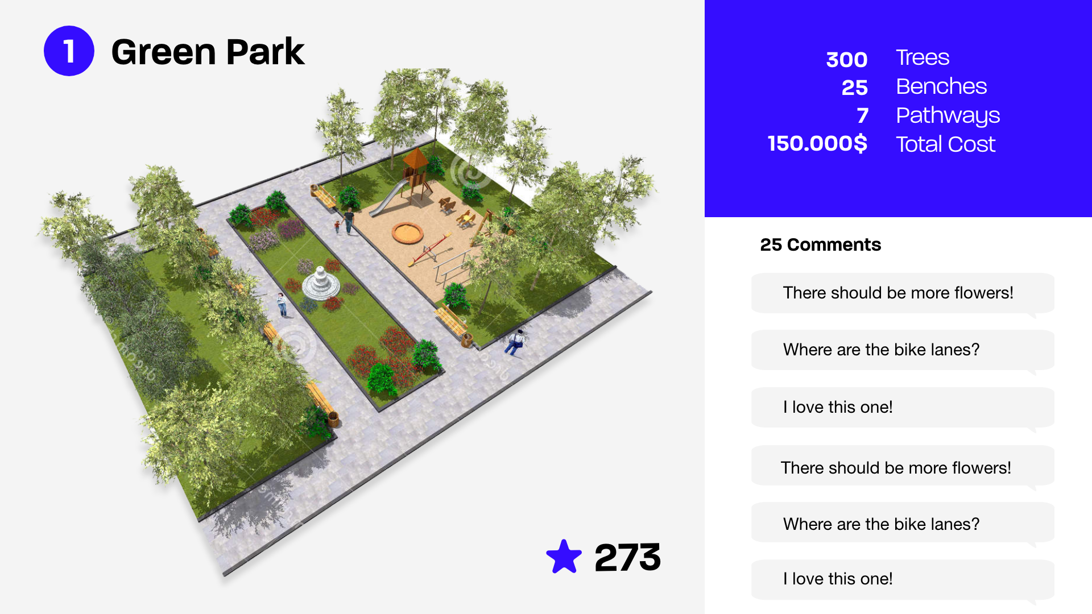
– Team 2
Mockups: View and interact with model

Slide 14
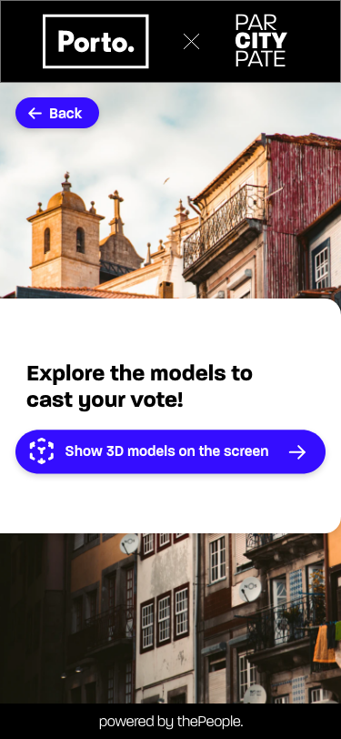
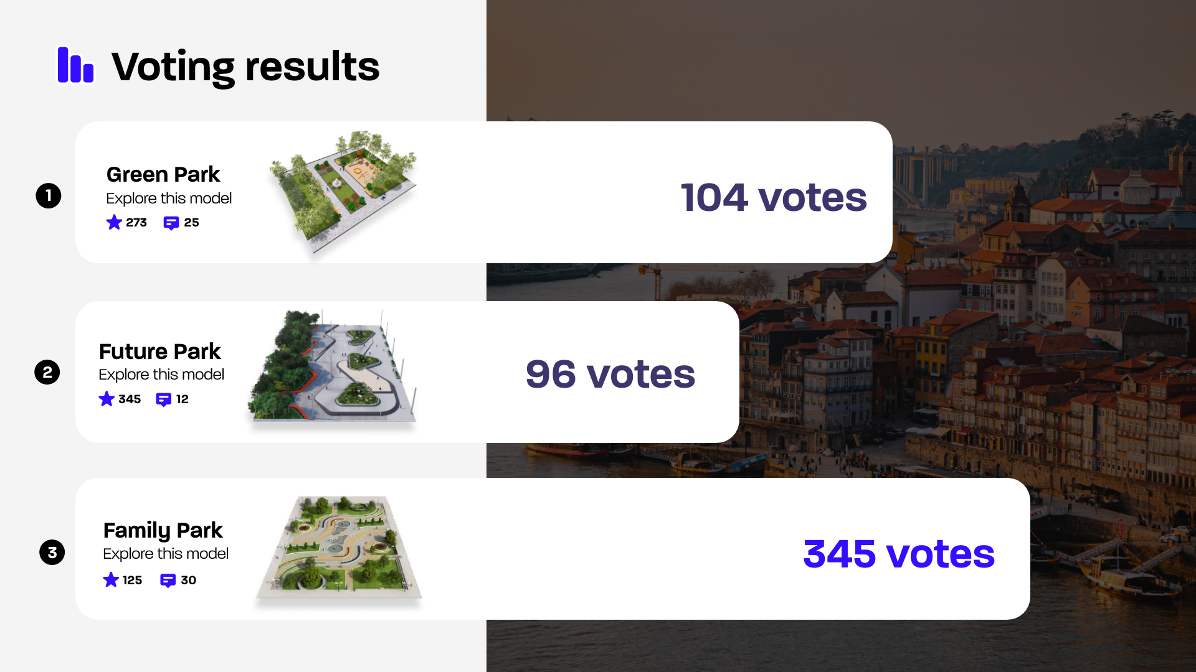
– Team 2
Mockups: Display votes

Slide 15




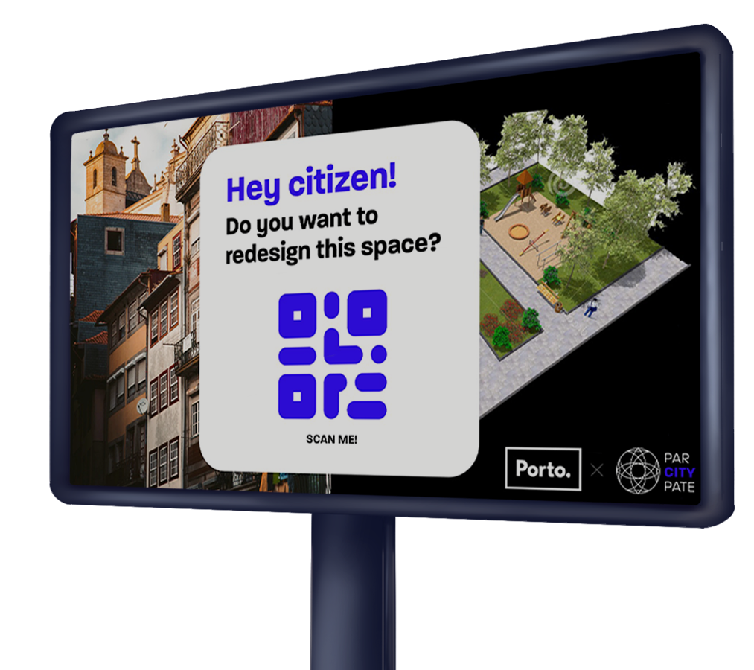

– Team 2
In a nutshell ...
FOR
WHO
THE
IS A
THAT
UNLIKE
OUR SOLUTION

